Slide 1
Agenda
Module 1: Introduction
Module 2: Commands
Module 3: Data And Streams
Module 4: Pipeline Introduction
Module 5: Introduction To Data Types
Module 6: Advanced Pipeline Operations
Module 7: Modules Introduction
Module 8: Advanced Data Types
Module 9: Functions, Scripts & Scope
Module 10: Flow Control

Slide 2
Module 1: Introduction
Section 1: PowerShell Introduction
What is PowerShell?
Evolution of PowerShell
Installation requirements
Section 2: Using PowerShell
Command-Line Interface (CLI)
PSReadline
Interactive Scripting Environment (ISE)

Slide 3
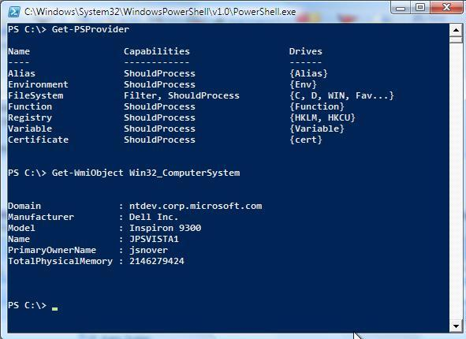
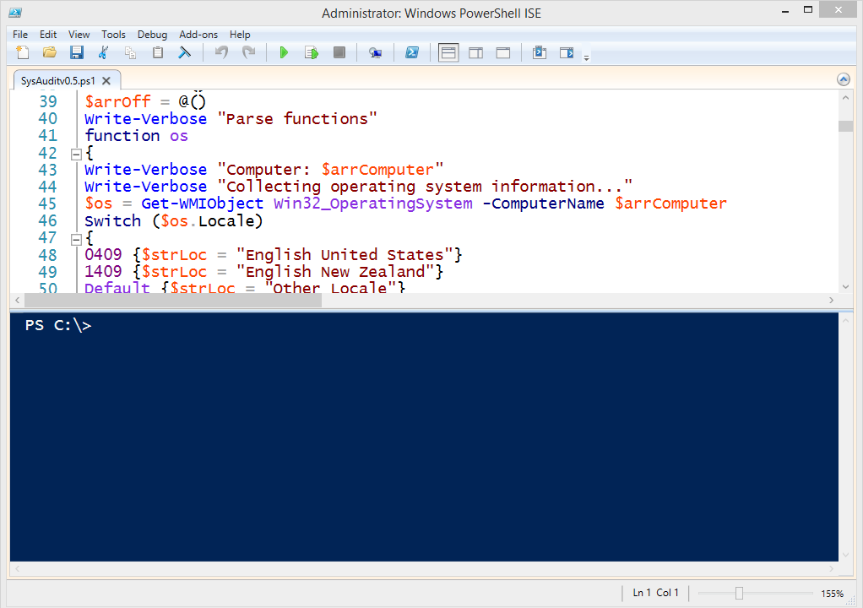
What is PowerShell?
Development Framework:
Integrated Scripting Environment
PowerShell Embedded in Host Applications
Automation Engine
Command-line Shell
Scripting Language
Notes:
PowerShell is not command prompt 2.0, it is just designed to look like it and be easy to pick up
Full scripting language, similar to Perl/Python/Lua

Slide 4
PowerShell Evolution
1.0
2006
2.0
2008
230 cmdlets
Backward-Compatible
3.0
2012
>2,300 cmdlets
Backward-Compatible
4.0
Code Name: Monad
2005
Backward-Compatible
Desired State Configuration (DSC)
WinPE
Web Access
Integrated Shell Environment (ISE)
Remoting
Enhanced ISE
Workflow
2013
>2,300 cmdlets
130 cmdlets
5.0
Package Management
PowerShell Get
CMS module
Remote debugging
2015
DSC additions
Transcription
Notes:
Huge overhaul to the language in PS v3.0. Lots of convenience things that won’t be present on v2.0 machines, which we will try to call out as we go incase you have v2.0 machines still.

Slide 5
PowerShell default availability
Windows PowerShell is a Windows feature
Windows PowerShell 4.0
Windows 8.1
Windows Server 2012R2
Windows PowerShell 3.0
Windows 8
Windows Server 2012
Windows PowerShell 2.0
Windows 7
Windows Server 2008 R2
Windows PowerShell 1.0
Windows Server 2008
Windows PowerShell 5.0
Windows 10
Windows Server 2016

Slide 6

System Requirements
.NET Framework
.NET Framework v4.5
OS
Windows Server 2016
Windows 10
Windows Server 2012 or 2012 R2
Windows 8.1
Windows Server 2008 R2 SP1
Windows 7 SP1
5.0
Other
WMI, WinRM and Server Manager CIM Provider (included in Windows or WMF)
Notes:
**IMPORTANT**
https://msdn.microsoft.com/en-us/powershell/wmf/5.0/productincompat
Compatible:
Microsoft SharePoint Server 2013
System Center 2012 Configuration Manager
Not Tested:
Microsoft SharePoint Server 2010
System Center 2012 Virtual Machine Manager
Incompatible:
Microsoft Exchange Server 2013
Microsoft Exchange Server 2010 SP3
Skype for Business Server 2015
Microsoft Lync Server 2013
Microsoft Lync Server 2010
System Center 2012 R2 Service Management Automation

Slide 7
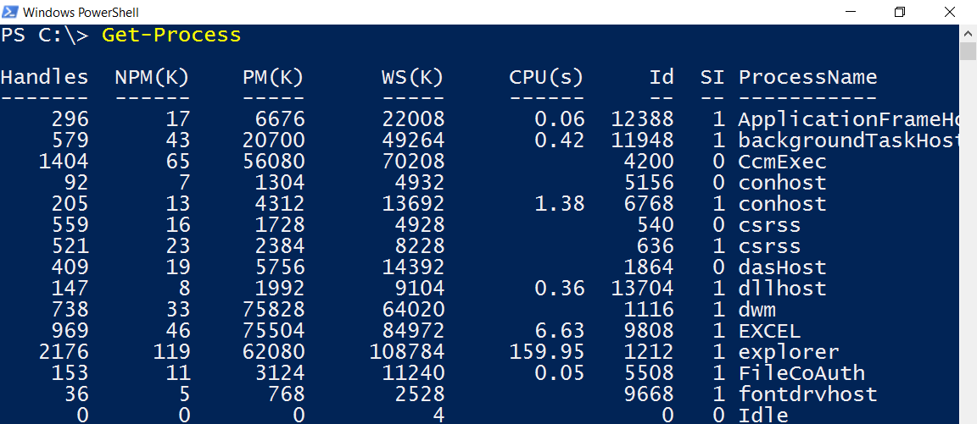
Command-Line Interface (CLI)
Interactive mode
Simple commands to interact with applications and the operating system
Handy shortcut keys: HOME, END, F7, arrows, CTRL+arrows

Slide 8
PSReadline
It can be installed on versions of Powershell 3.0 and greater, but is now built in to WMF 5.
PsReadline adds some distinct features to the console:
Syntax coloring
Simple syntax error notification
A good multi-line experience (both editing and history)
Customizable key bindings
Cmd and emacs modes (neither are fully implemented yet, but both are usable)
Many configuration options
Bash style completion (optional in Cmd mode, default in Emacs mode)
Bash/zsh style interactive history search (CTRL-R)
Emacs yank/kill ring
PowerShell token based "word" movement and kill
Undo/redo
Automatic saving of history, including sharing history across live sessions
"Menu" completion (somewhat like Intellisense, select completion with arrows) via Ctrl+Space
Notes:
PSReadline was a module developed by Jason Shirk.
Demo some of the features of PSReadline:
Open the shell, show syntax highlighting: Get-Process –Name “PowerShell”
Close shell, reopen, hit up, show persistent history
Ctrl+Z to undo
Type: Get-Pro then Ctrl+Space
Type: Get-Process - then Ctrl+Space

Slide 9
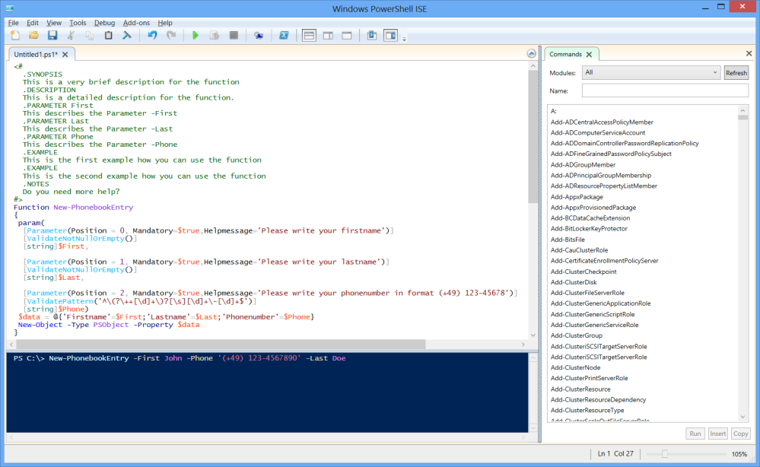


Integrated Scripting Environment (ISE)
Development Tool
Graphical Editor
Execution
Debugging
We teach debugging in our advanced workshops
Can be launched from running POWERSHELL_ISE.EXE
Start Menu Tile
Taskbar Tile
Notes:
hotkeys (Ctrl-1,Ctrl-2,Ctrl-3) for layouts. There’s also a toolbar that can be hidden from the View menu.
All Panes have a vertical scrollbar, | out-host –Paging is not supported.
ISE can’t emulate older version of powershell
I prefer to demo the following:
Show them the panes
Show them the following buttons: Run, Run Selected, layout options, toggle show commnd add-on
Run interactive stuff in the shell like a normal CLI session
Intellisense auto-complete for: Cmdlets, Parameters, Values
Customize syntax highlighting with custom theme
Comments
Collapsable code + #region #endregion (make sure to mention case sensitivity here)
Brace matching
History (# then space)
Snippits (ctrl + J)
Add-ons

Slide 10
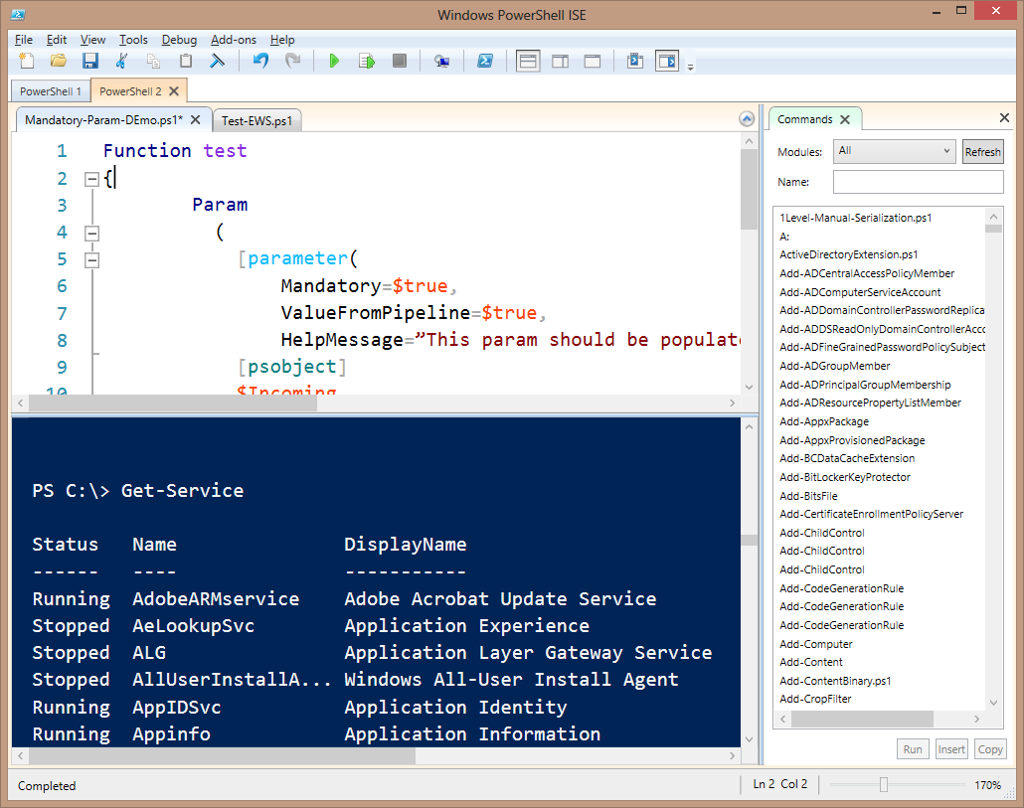
Anatomy of the ISE
PowerShell tabs
Script pane
Scripts open within a tab
Show-Command add-on
Console pane
Notes:
hotkeys (Ctrl-1,Ctrl-2,Ctrl-3) for layouts. There’s also a toolbar that can be hidden from the View menu.
All Panes have a vertical scrollbar, | out-host –Paging is not supported.
ISE can’t emulate older version of powershell
I prefer to demo the following:
Show them the panes
Show them the following buttons: Run, Run Selected, layout options, toggle show commnd add-on
Run interactive stuff in the shell like a normal CLI session
Intellisense auto-complete for: Cmdlets, Parameters, Values
Customize syntax highlighting with custom theme
Comments
Collapsable code + #region #endregion (make sure to mention case sensitivity here)
Brace matching
History (# then space)
Snippits (ctrl + J)
Add-ons

Slide 11
Auto-Save and Crash Recovery
Auto-Save
ISE automatically saves scripts to ‘alternate location’
Default save interval is 2 minutes
Interval is editable via menu and object model
Crash Recovery
Uses alternate auto-saved files to restore un-saved scripts
Rich Copy to and from the ISE
Clipboard includes colors, font, size, etc.
Excellent feature for sharing code in email, pptx, docx, etc.
Notes:
Tools -> Options -> General Settings AutoSave:
$env:localappdata\microsoft_corporation\powershell_ise*\3.0.0.0\AutoSaveFiles

Slide 12
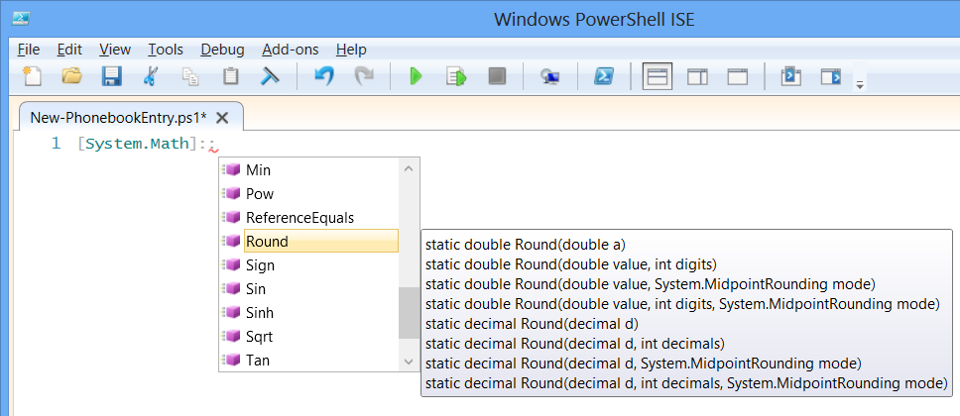
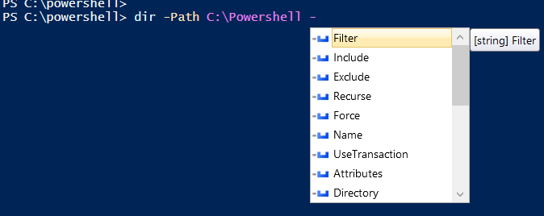
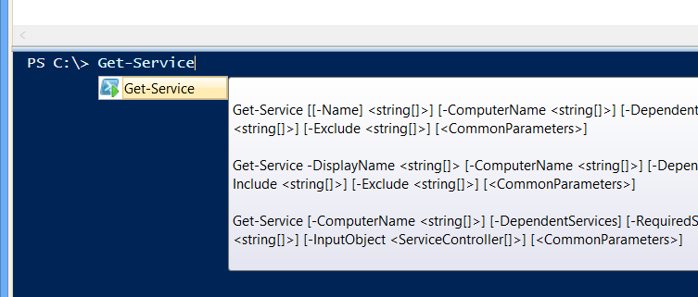
ISE IntelliSense
Examples on following slides
Similar to Visual Studio IntelliSense
Dynamically suggests code and provides help as you type
Keyboard-based tab completion still works
Mouse or keyboard can be used to leverage IntelliSense popups
Works in Script and Command Pane
Notes:
The new ISE includes IntelliSense: the editor knows what you are editing and provides intelligent suggestions for that particular context.
It goes beyond simple auto-completion to provide names of cmdlets, functions, scripts, workflows, parameters, object properties and methods, paths, files, variables, and enumeration values. IntelliSense can show object properties and methods using the TAB key. As an improvement from previous versions, it can show them from types and variables, and even DotNet classes. You can enable, disable and configure IntelliSense in the Options menu.

Slide 13
Example: IntelliSense Parameters
Cmdlet or function parameters appear in a pop-out window
Parameter value types shown in a secondary window

Slide 14
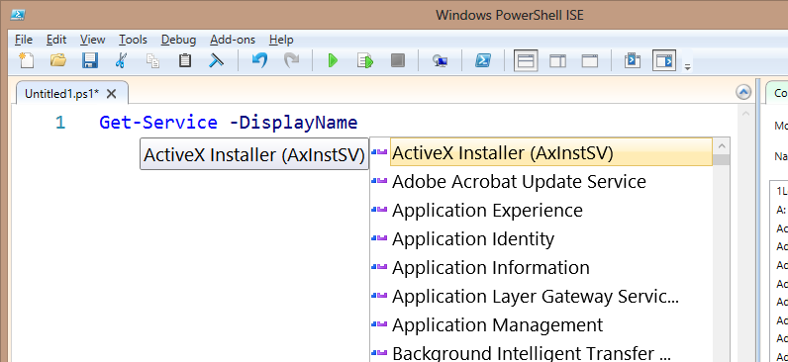
Example: IntelliSense Parameter Arguments
Some cmdlet parameters display parameter values
Notes:
This works for enumerations and ValidateSet.

Slide 15
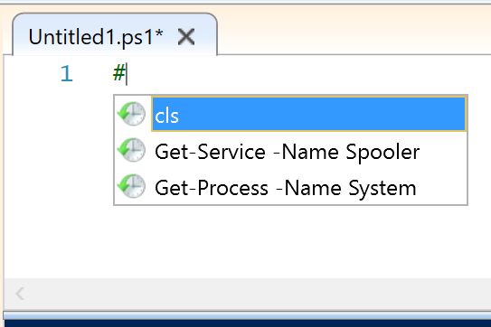
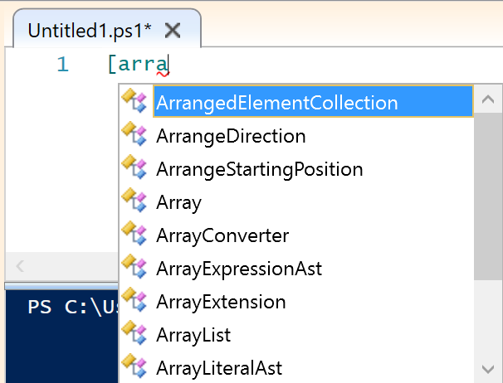
History
Typing # followed by Ctrl+Space shows your command history at a glance.
Types and Namespaces
Typing [arra followed by Ctrl+Space shows types and namespaces in drop-down.

Slide 16
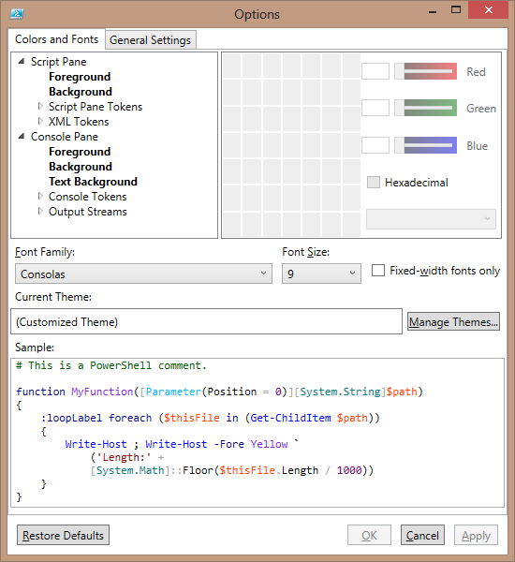
Syntax Color Highlighting
ISE includes enhanced syntax highlighting
Color highlighting is automatic and customizable
Tools-Options window (shown), includes detailed token, stream, and console colorization settings
Themes to make common color sets easy to use
Notes:
You can customize many options in the ISE without using the object model or add-ons. All settings are centralized in a menu available in Menu | Tools | Options. Some options : - All colors and fonts in both Console and Script panes. - The texts are also color-coded based on tokens and each can have a
configurable color:
- Auto-Save for files - Line Numbering - IntelliSense general settings You can also define themes. You can choose a color layout and export it as a file (.StorableColorTheme.ps1xml). You can import it again in later sessions.
Attribute
Command
CommandArgument
CommandParameter
Comment
GroupEnd
GroupStart
Keyword
LineContinuation
LoopLabel
Member
NewLine
Number
Operator
Position
StatementSeparator
String
Type
Unknown
Variable

Slide 17
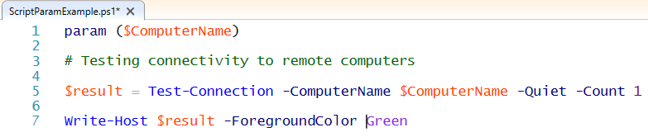
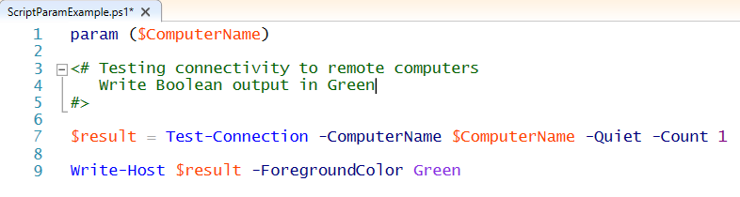
Comments in Scripts
Comments in Scripts are used to convey meaning to anyone reading the Code.
They are not executed or displayed during execution.
Well Commented code is easier to comprehend because the comments explain what the code is doing.
Examples:
Single-Line Comments
#
Comment character
Block Comments
<#
#>
Opening/Closing Tag

Slide 18
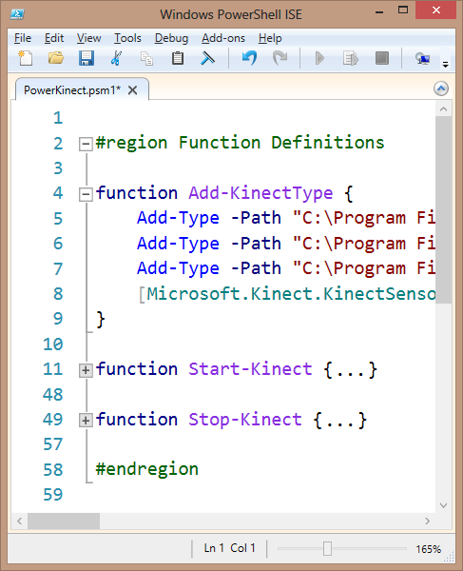
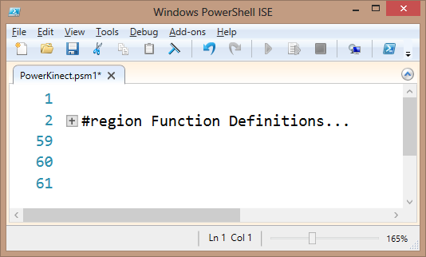
Collapsable Code
Code can be collapsed for easier reading
Functions, Script block, Parenthesis, Quotes, etc. can be collapsed spanning multiple lines
Manual code regions allow collapsing between any two lines
#region – Begin a Region
#endregion – End a Region
Region tags must be lowercase
Optional text following the #region tag can help with code documentation

Slide 19
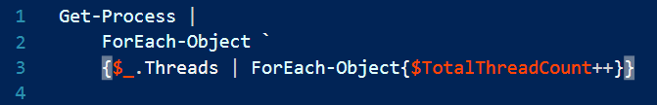
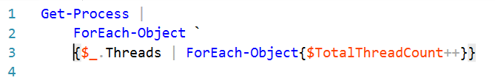

Brace Matching
ISE script pane will highlight matching braces when cursor positioned outside
Works with: { Curly Braces }, ( Parentheses ), [ Square Brackets ]
Find paired braces with ISE menu: Edit – Go to Match ( CTRL-] )
Note: Subtle grey highlighting when cursor in front of curly brace
Notes:
Demo or mention the hotkey CTRL - ] to trigger it.

Slide 20
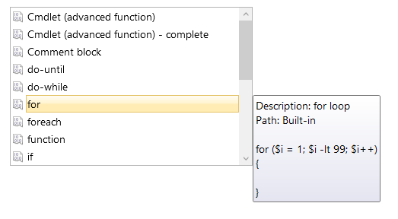
ISE Code Snippets
Pre-created blocks of code
Inserted at cursor
Three kinds of snippets:
Default (included with ISEv3/4)
User-Defined
Module-Based
Keyboard Shortcut - Ctrl-J
Edit Menu, “Start Snippets”
Example on next slide
Notes:
You can see the available snippets from the “Edit” menu, “Start Snippets”, or by pressing Ctrl+J.
You can define your own snippets and import snippets from modules. Cmdlets: Get-ISESnippet, New-ISESnippet, Import-ISESnippet (current session only)
Great for beginners, but the advanced ones and custom ones can save a lot of time for veterans as well

Slide 21
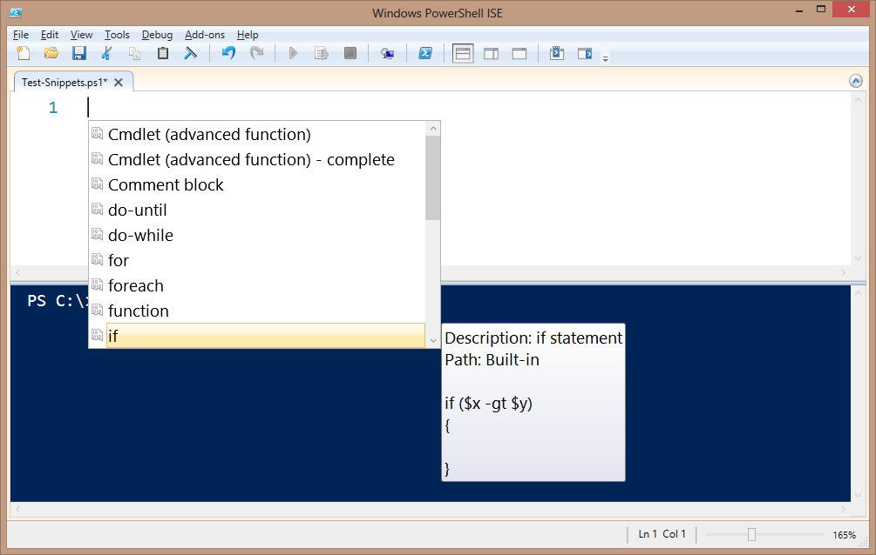
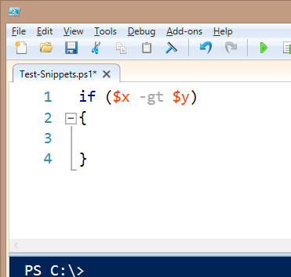
Example: ISE Snippet Insertion
Click Enter to choose snippet
and insert code
Ctrl-J
or
Edit -> Start Snippets

Slide 22
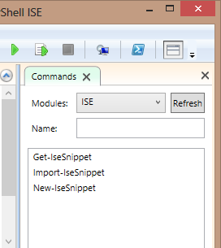
ISE Compiled Add-Ons
Compiled add-ons allow for rich functionality to be created, such a variable watch window
Compiled add-ons are WPF-based controls
The built-in Show-Command Add-On is a good example of a compiled add-on
Look for compiled add-ons coming from the PowerShell community and informally from Microsoft
Notes:
You can find an entry “Add-Ons” on the main menu. Inside it, you’ll see a link to the Add-Ons website. There you can find several ready to use Add-Ons and the development guidelines if you want to create one. The Add-ons menu also contains options for the display layout of the loaded add-ons. Usually they are displayed on the right side pane (the command pane is an add-on loaded by default), but you can move or hide them. You can also find add-ons people have created and hosted online in other places.
Link for WPF (Windows Presentation Foundation) -- https://msdn.microsoft.com/en-us/library/ms754130(v=vs.110).aspx

